Slide 1
Open Source Intelligence

Slide 2
Harvester

Slide 3
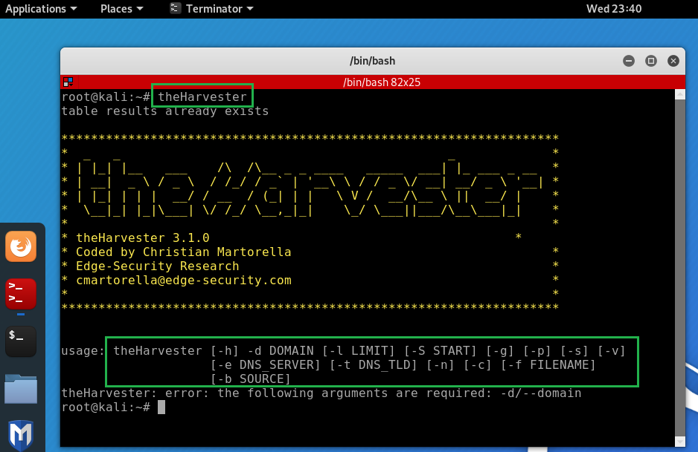
What is Harvester
Names of organizational members, email addresses, web host, domain names, and even open ports

Slide 4
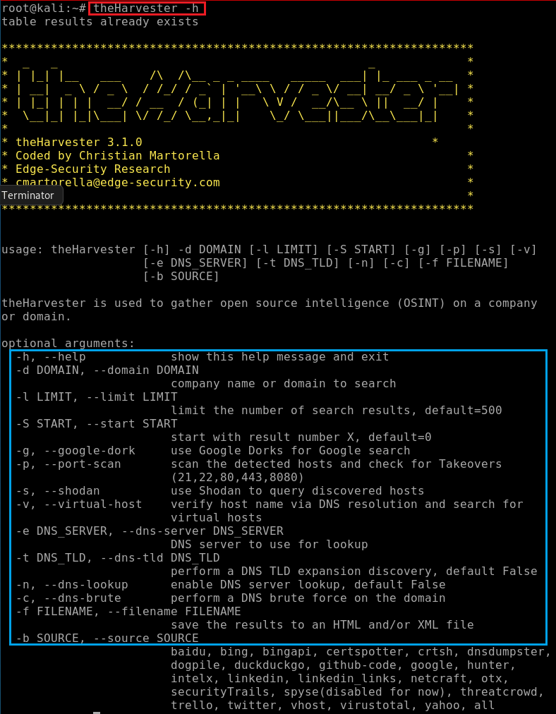
Help function

Slide 5
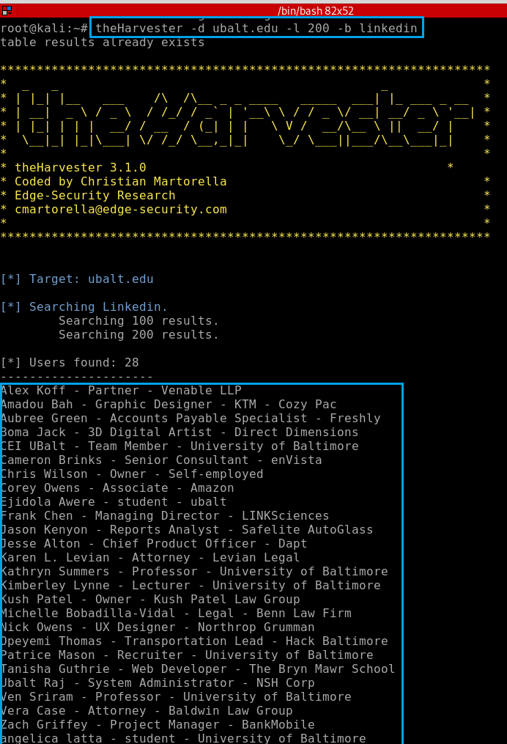
Searching LinkedIn that are related to the ubalt.edu domain
Note: Llinkedin may block your IP if you search many times.

Slide 6
dns enumeration
dnsenum

Slide 7
What is DNS
Multiple servers
Domain Name System (DNS) is the phonebook of the Internet.
DNS resolution involves converting a hostname (such as www.example.com) into a computer-friendly IP address (such as 192.168.1.1)

Slide 8
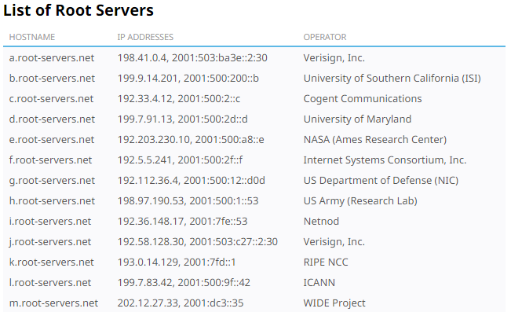
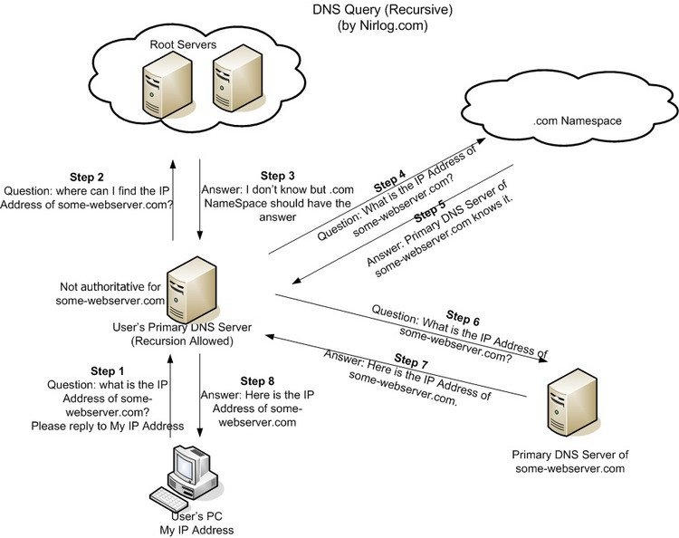
DNS resolution process
DNS recursor
a librarian
Root nameserver
an index in a library
TLD nameserver
top level domain server (.com)
a specific rack of books in a library.
Authoritative nameserver
a dictionary on a rack of books
(example.com, 192.21.21.12)

Slide 9
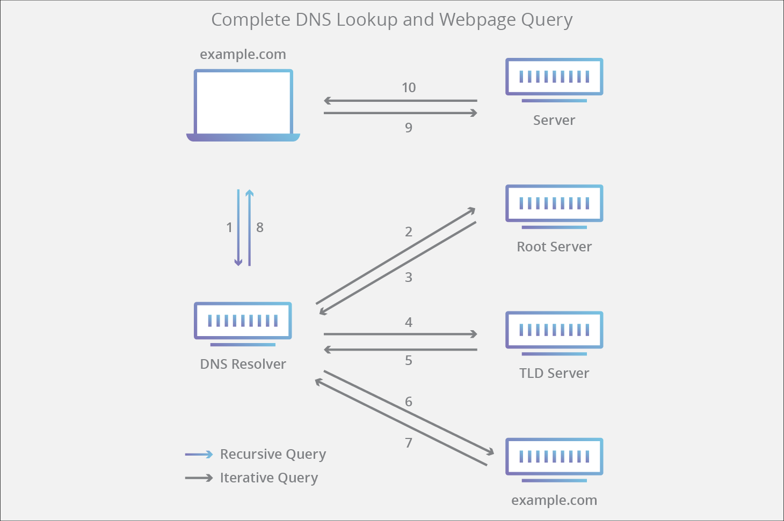
https://www.cloudflare.com/learning/dns/what-is-dns/

Slide 10
DNSenum
A tool that it was designed with the purpose of enumerating DNS information about a domain.

Slide 11
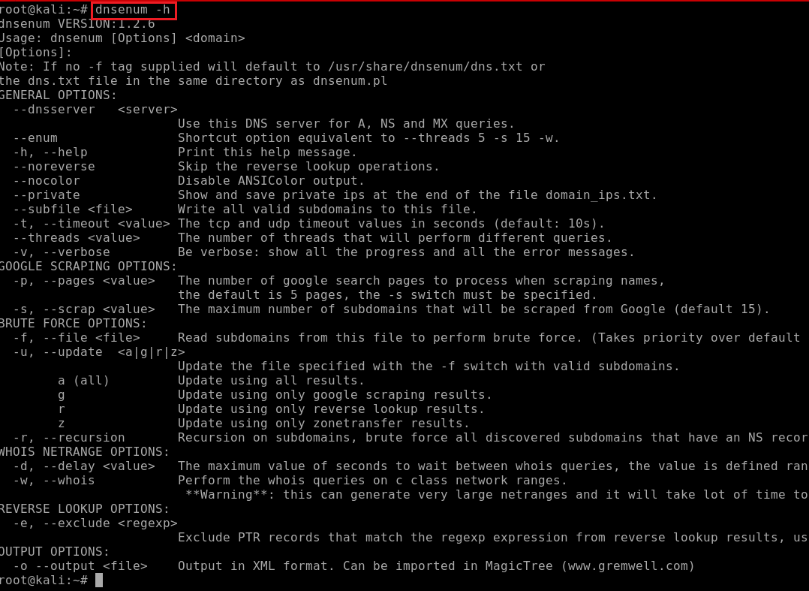

Slide 12
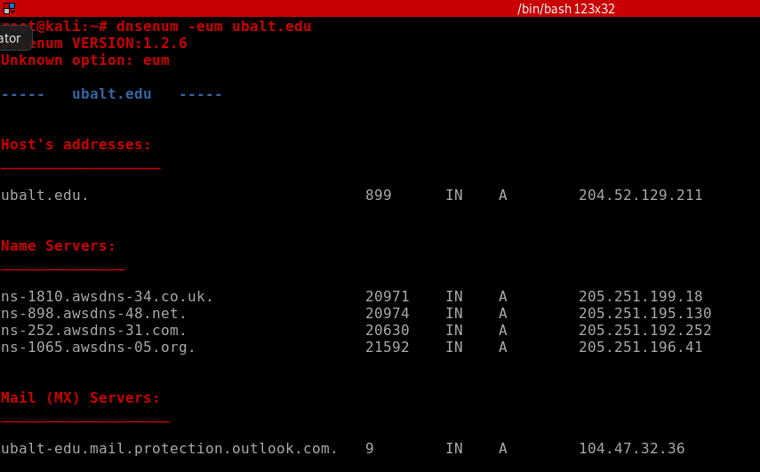

Slide 13
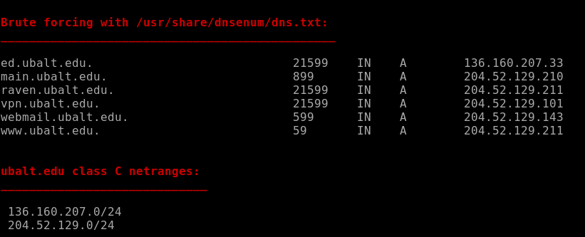

Slide 14
dig

Slide 15
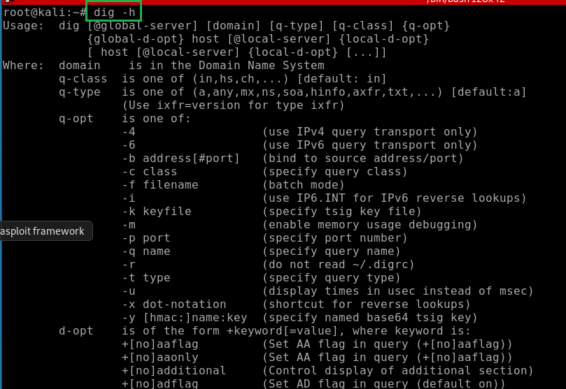

Slide 16
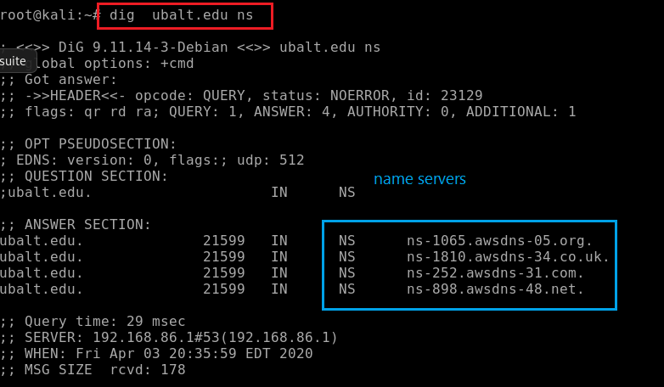
Name server

Slide 17
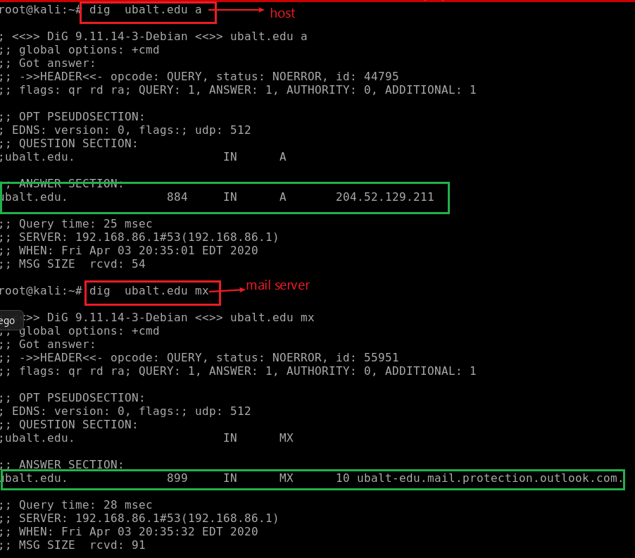
Host IP/Email IP

Slide 18
whois

Slide 19
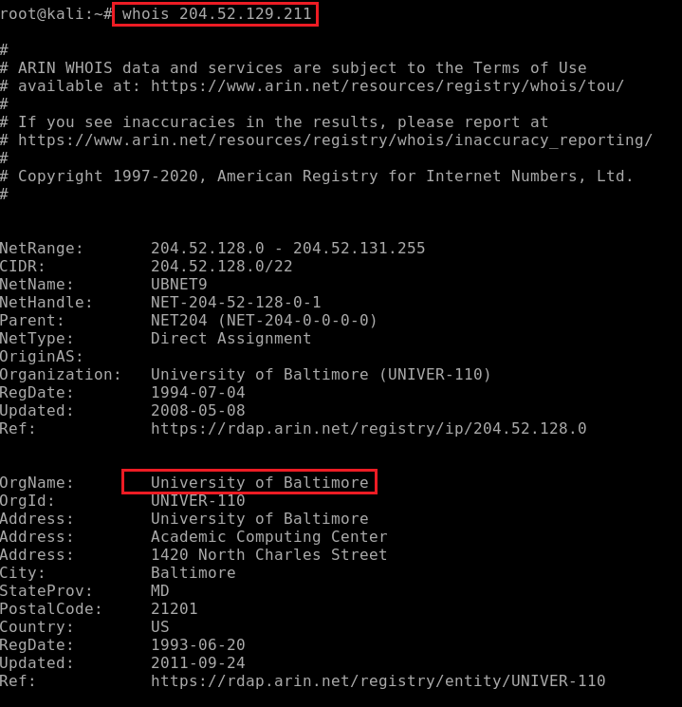

Slide 20
Google Hacking Database

Slide 21
Google Hacking Database
a database of queries used by hackers to identify sensitive data on your website
portal logon pages,
logs with network security information
https://www.exploit-db.com/google-hacking-database/

Slide 22
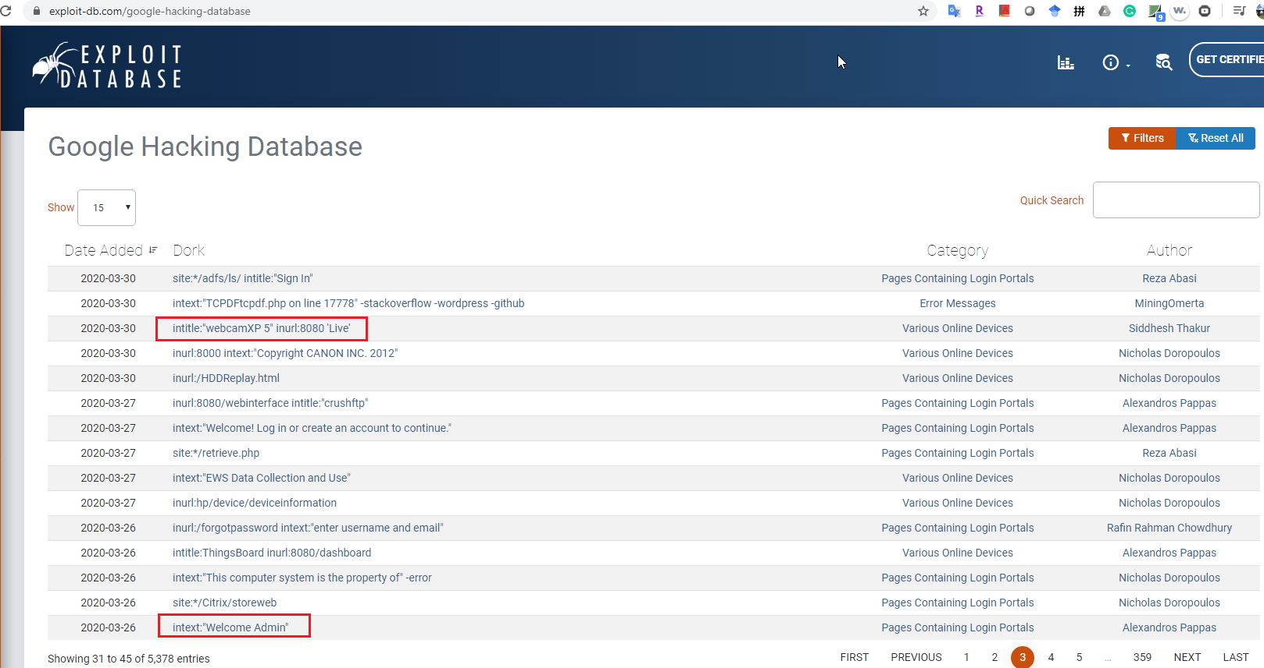

Slide 23
Metagoofil

Slide 24
Metagoofil : an information gathering tool
Extract metadata of public documents (pdf,doc,xls,ppt,docx,pptx,xlsx) belonging to a target company.

Slide 25
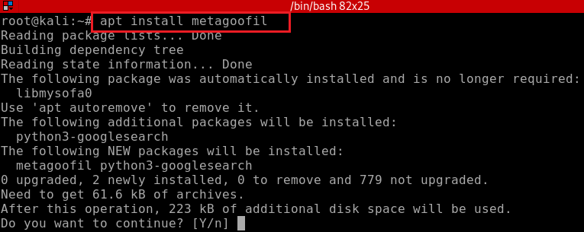
installation

Slide 26
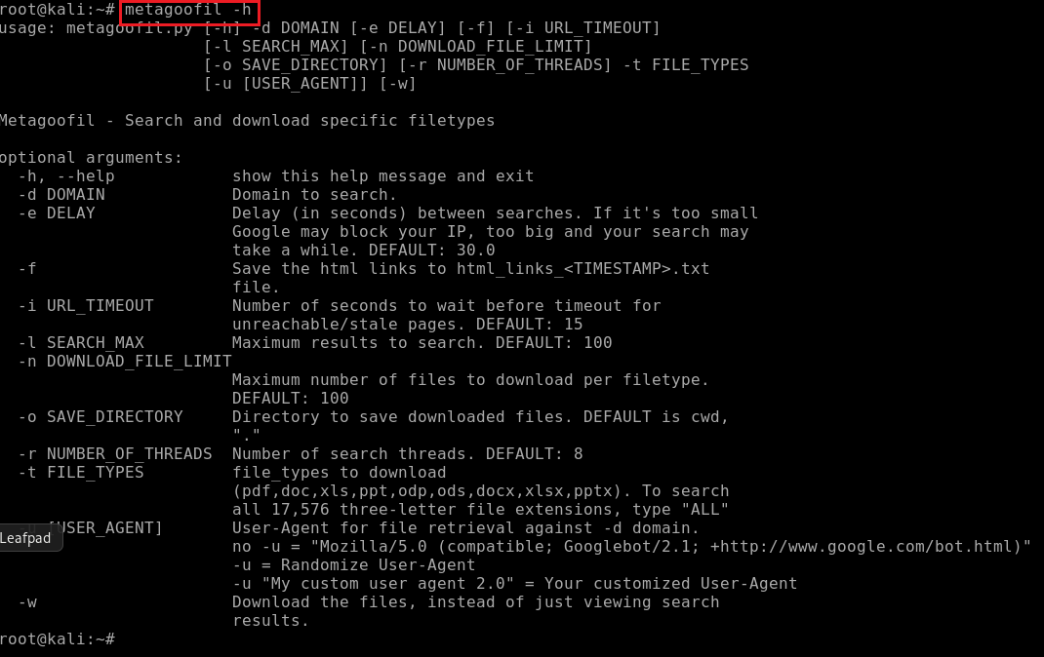

Slide 27
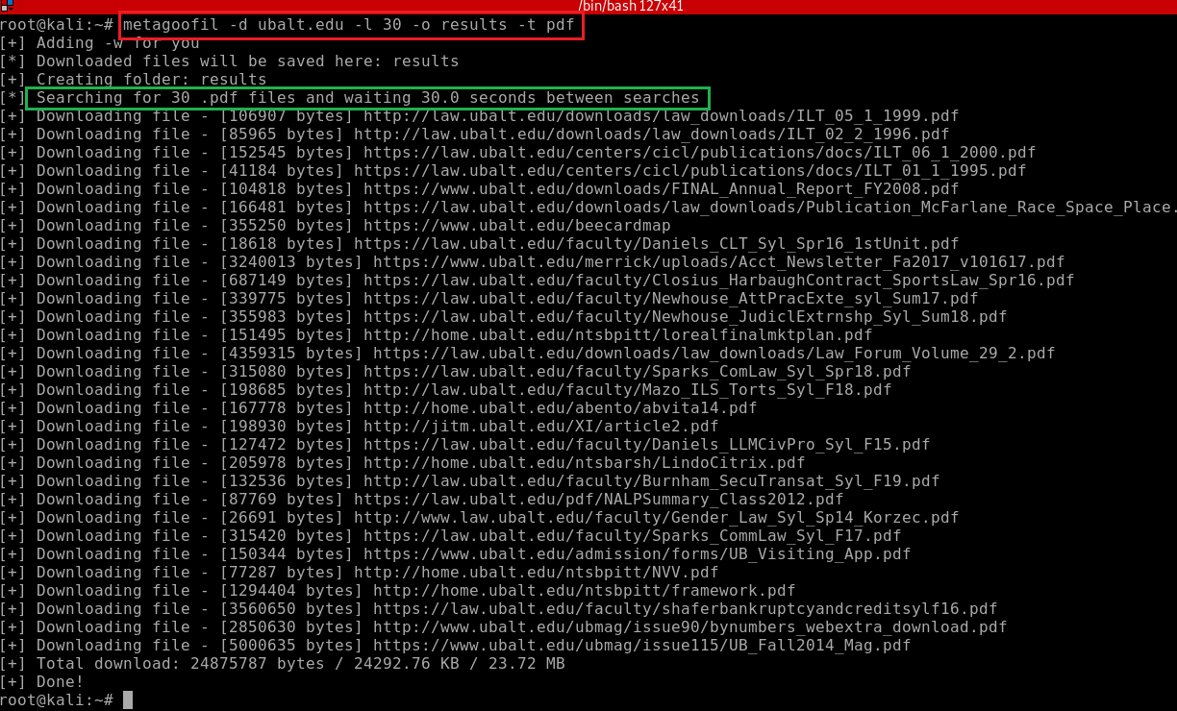
Files are saved in /results directory

Slide 28
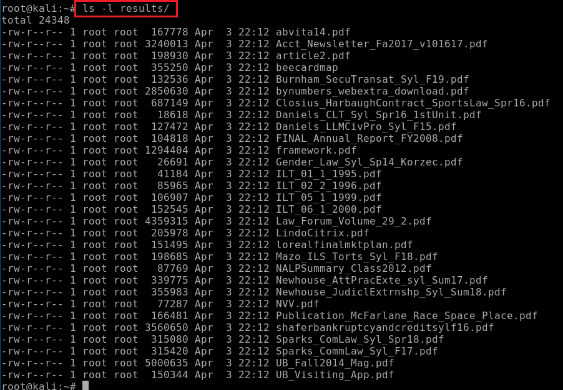

Slide 29
Maltego

Slide 30
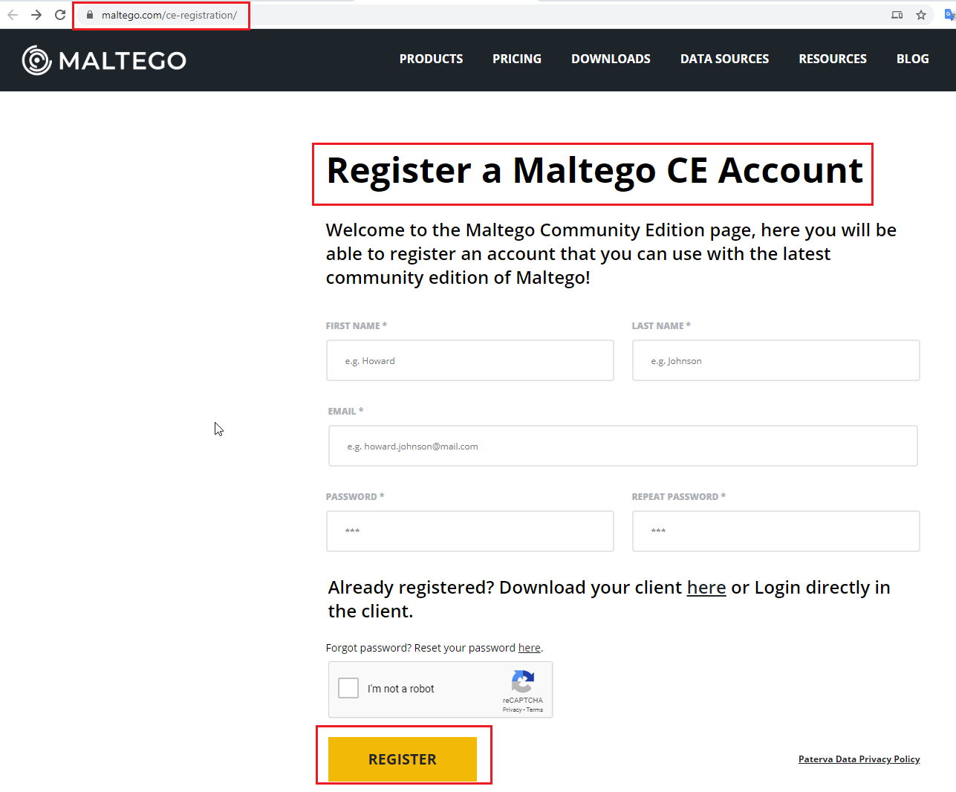
Register first
https://www.maltego.com/ce-registration/
Notes:
MA

Slide 31
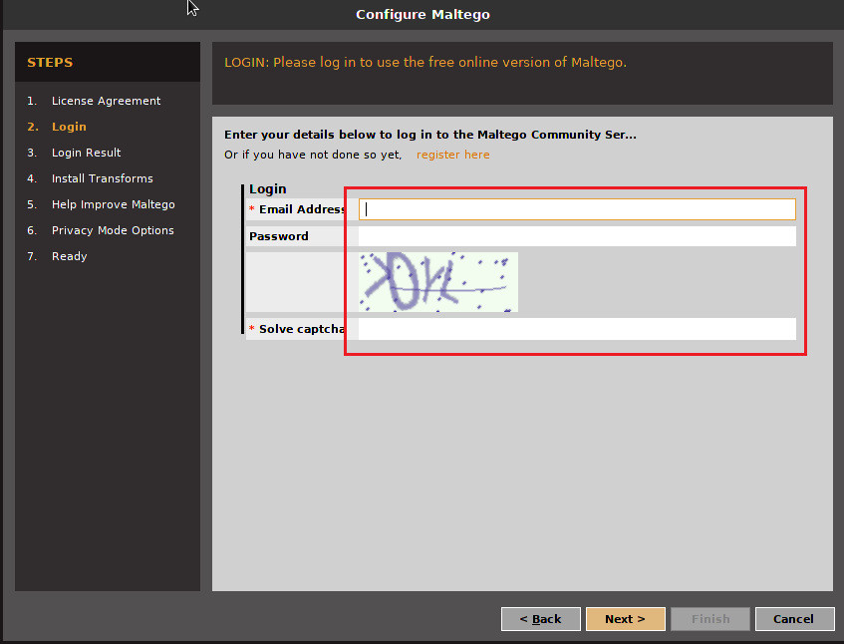
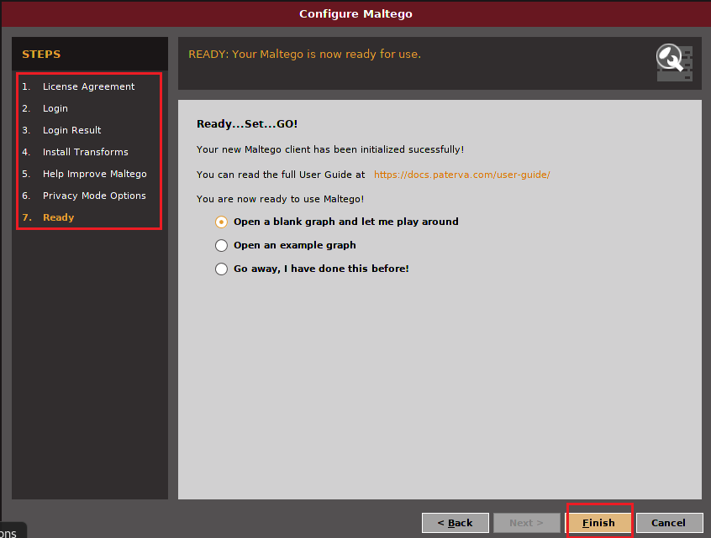

Slide 32
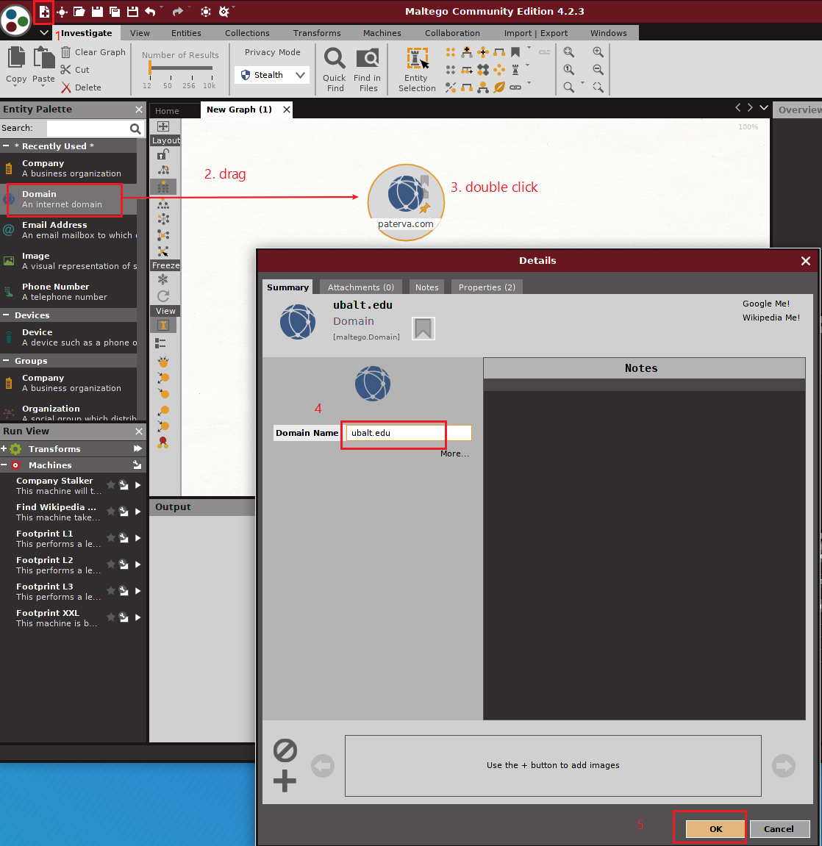

Slide 33
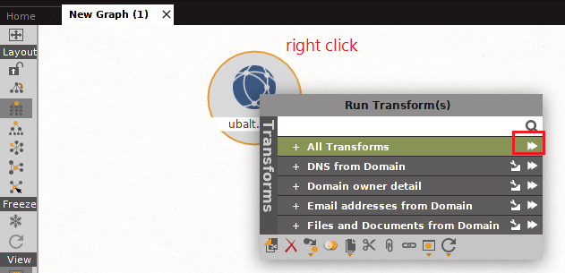

Slide 34
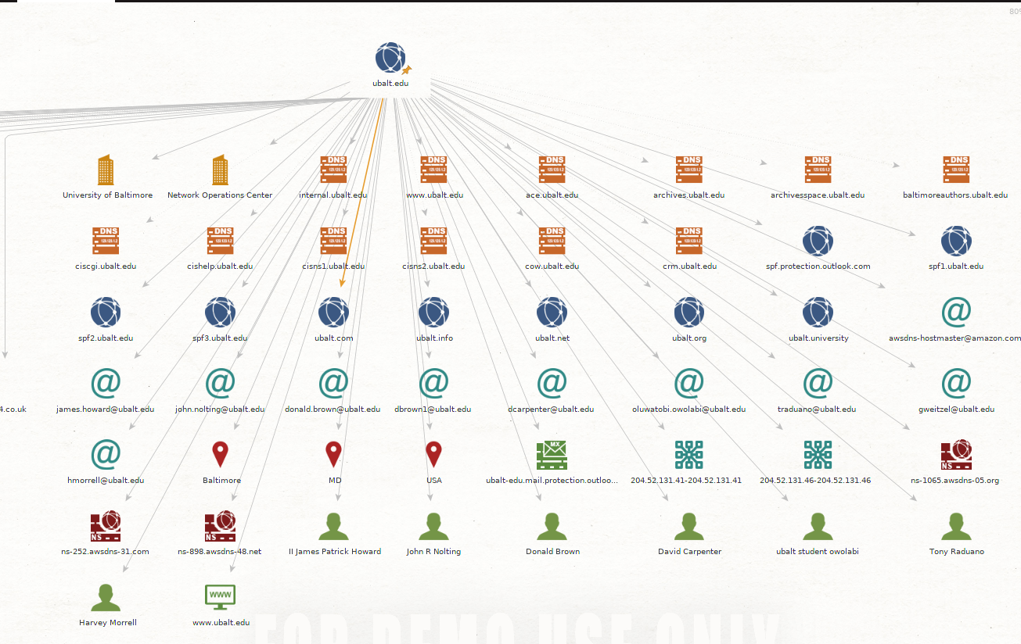

Slide 35
Reference
http://www.cs.virginia.edu/~dgg6b/book/OpenSourceIntelligence.html

